Slide 1
Mitron credit card dashboard
Problem Statement-- Mitron Bank is a legacy financial institution headquartered in Hyderabad. They want to introduce a new line of credit cards, aiming to broaden its product offerings and reach in the financial market.

Slide 2
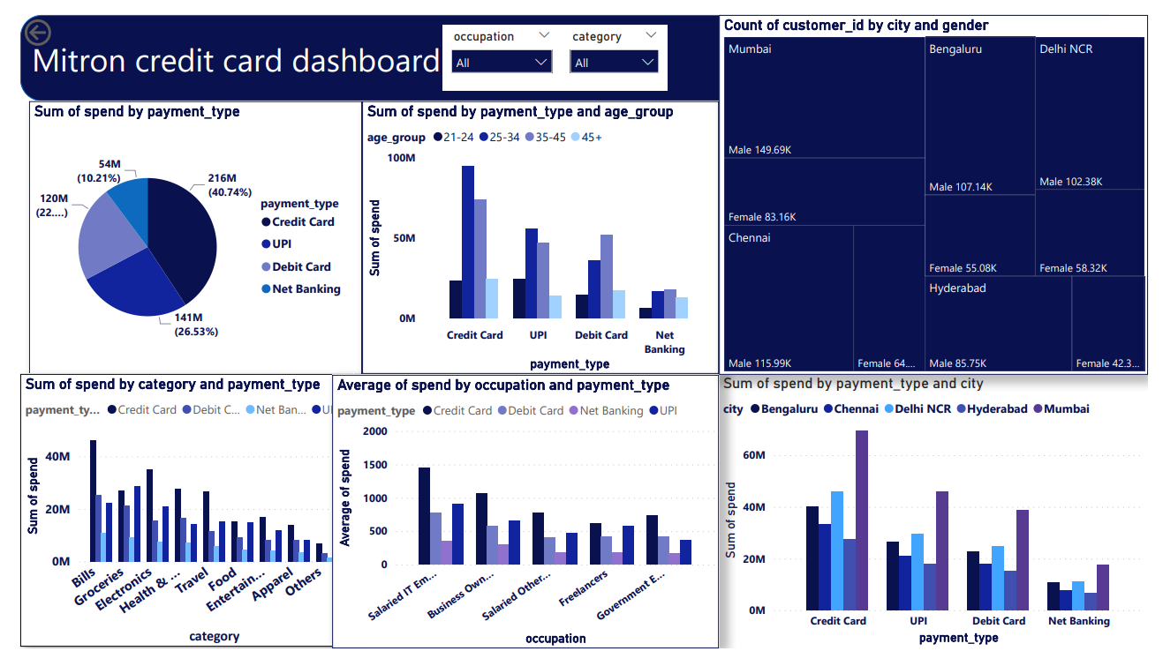

Slide 3
Steps being followed to execute this task
1.Clean and transform data using power query
1.remove duplicate
2.create custom column
3.change datatype
2.Make a dashboard by pie chart,bar chart ,tree map and slicer
.Dashboard details
Two slicers for occupation and category
Pie chart for payment type with average spend to understand which payment method being use more
Tree map to know count of customer by city and gender
Different bar chart to compare payment type with respect age,city,category and occupation by average spend

Slide 4
Colcusion from dashboard
40% spend occur through credit card
Age between 25-34 and occupation is it employee are using credit card more
For paying bills and buying electronics tools people are using credit card more.
Mumbai city people using credit card more.

